Slide 1

Book recommendation system
Team 30

Slide 2

Team Members:
1) Omar Ashraf Mostafa Samy 20p1542
2) Michael Joseph Adeeb 1901075
3) Omer Ashraf Abd-Elkhalik 17p6030

Slide 3

About the project
Recommendation systems are information filtering systems that deal with the problem of information overload by filtering vital information fragments out of large amounts of dynamically generated information according to a user’s preferences, interest, or observed behavior about a certain item. A recommendation system has the ability to predict whether a particular user would prefer an item or not based on the user’s profile.
The aim of this project is to build a book recommendation system that can provide interesting book recommendations to the user based on a book's popularity or the user's interests/preferences.
The eventual result of the book recommendation system is not to make accurate predictions but instead to provide difficult to quantify insightful book recommendations

Slide 4
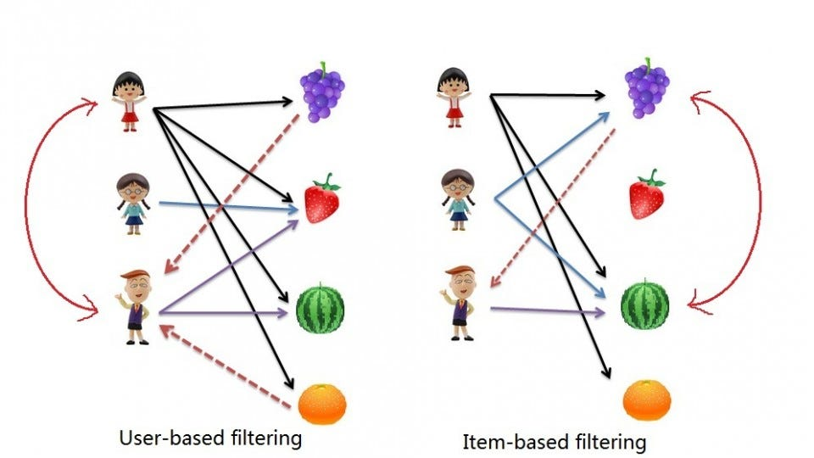
Methodology
1. Popularity Based Recommendation System

Slide 5
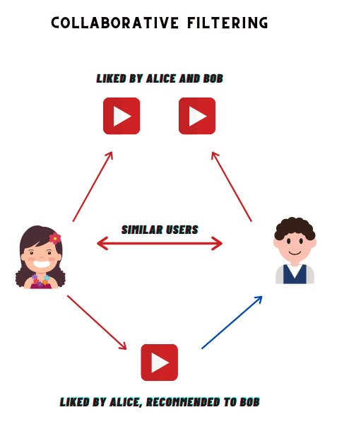
Methodology
2.Collaborative Filtering Based Recommendation System.

Slide 6

Simple Popularity recommendation
Country-Based recommendations
- Relevence recommendations
- Author based recommendations
- Popularity threshold recommendations

Slide 7

Collaborative Filtering Based Recommendation System.
- KNN model
- Matrix Factorization
- ⁠KNN with cousine metric
- ⁠KNN with eculidian
- ⁠support vector regression model SVR
⁠support vector regression model SVR

Slide 8
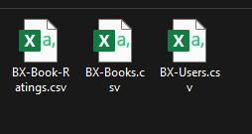
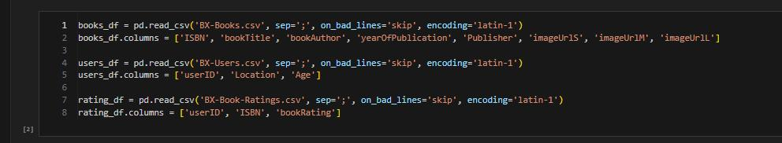
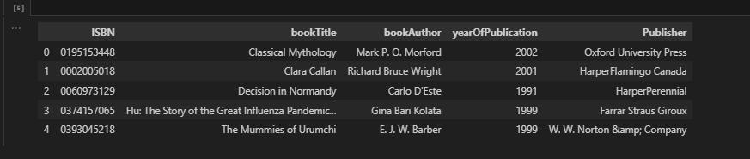
Data extraction

Slide 9
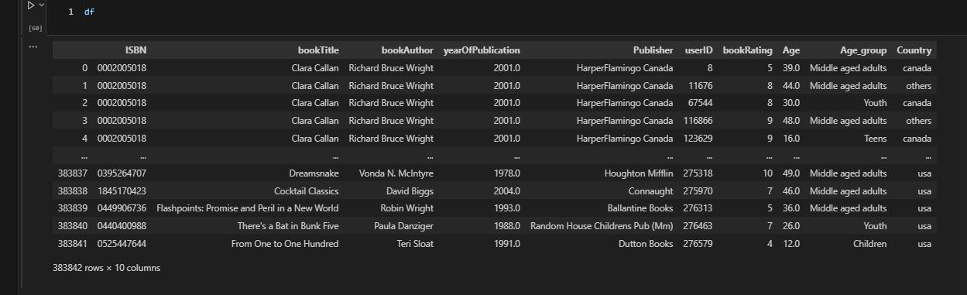
Data cleaning

Slide 10
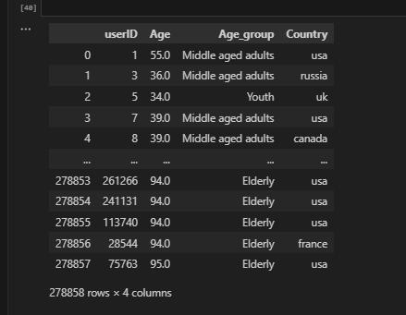
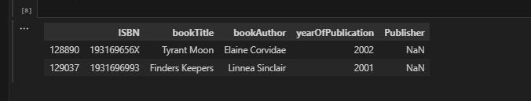
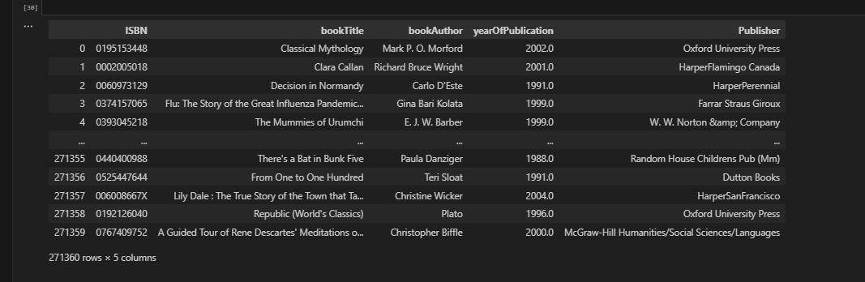
Data cleaning

Slide 11
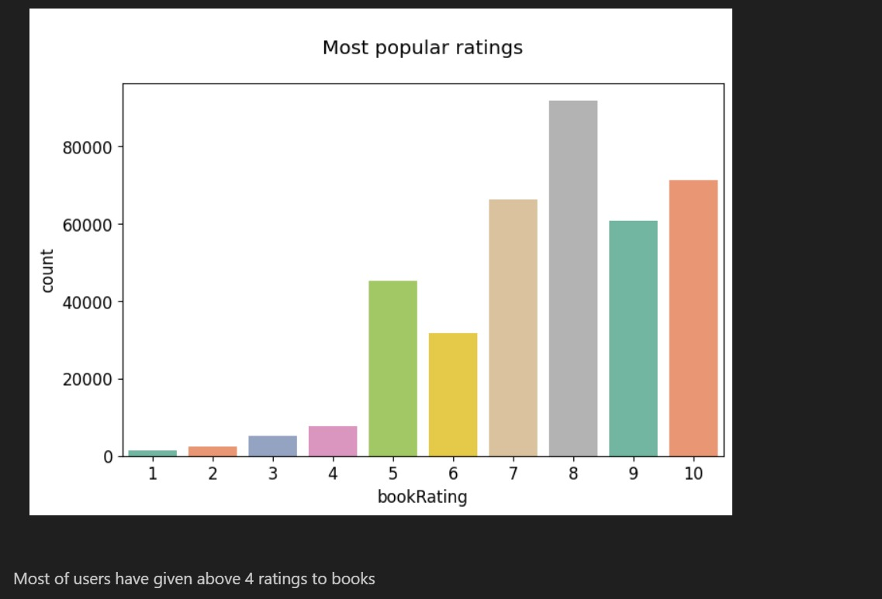
EDA (Exploratory Data Analysis)
we used it to showcase ofdata distribution

Slide 12
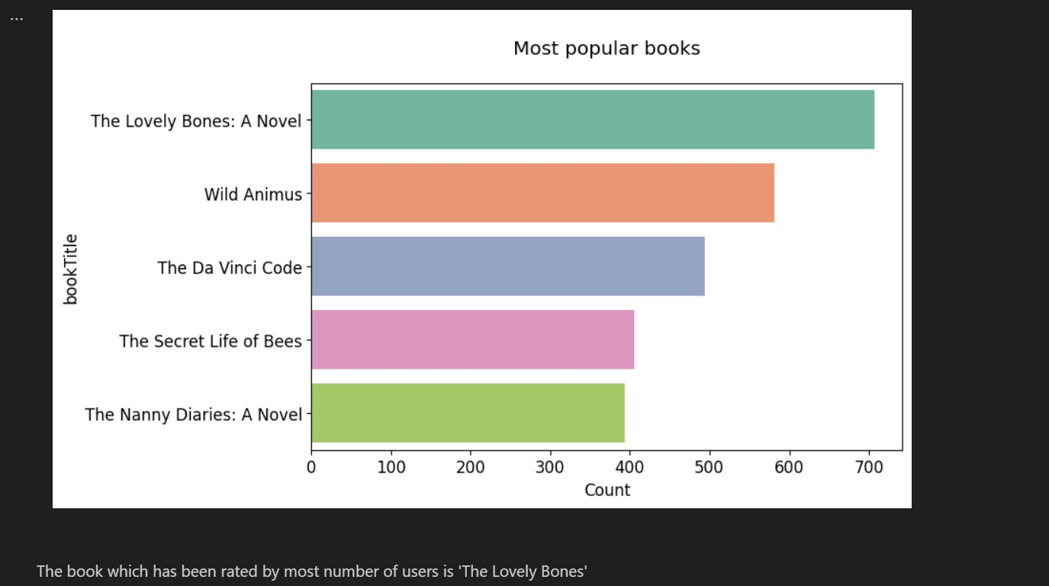
Top 5 most popular books

Slide 13
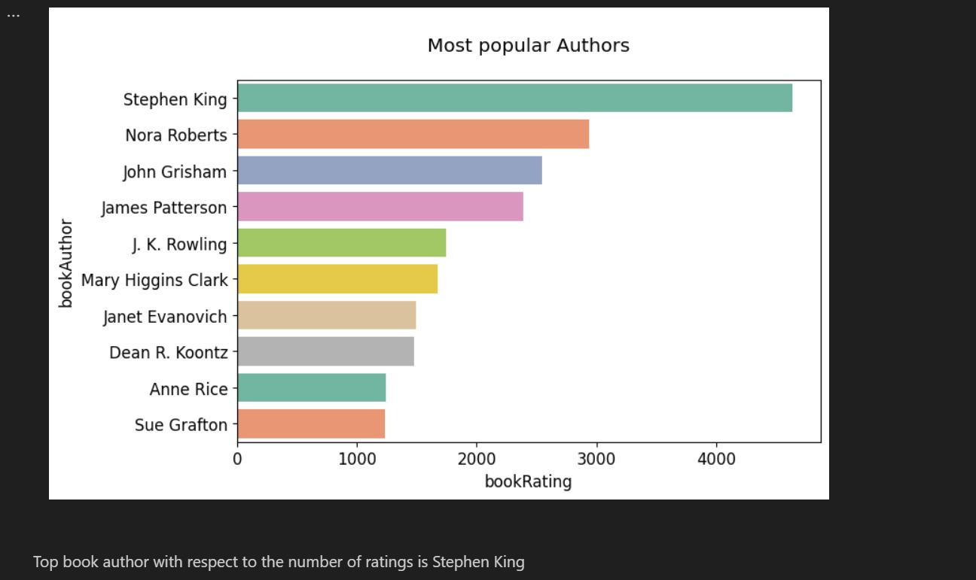
Most popular book Authors

Slide 14
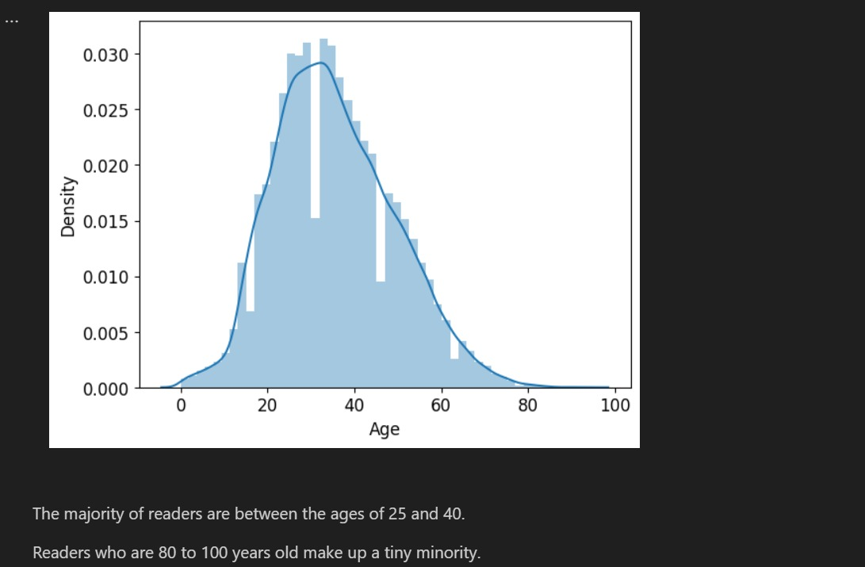
Age distribution of users

Slide 15
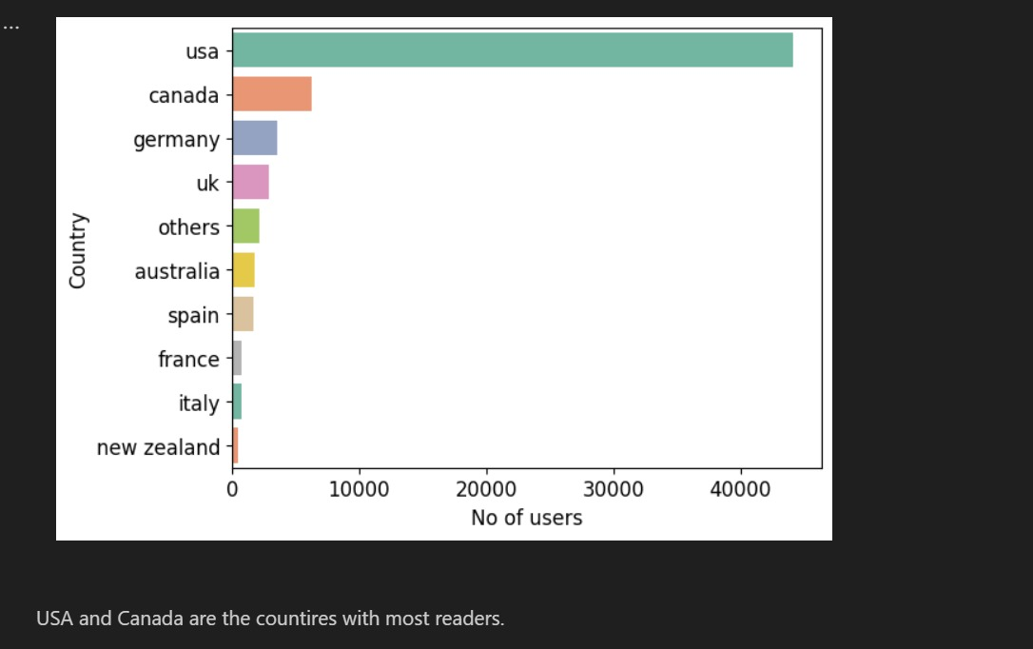
countries with most readers

Slide 16
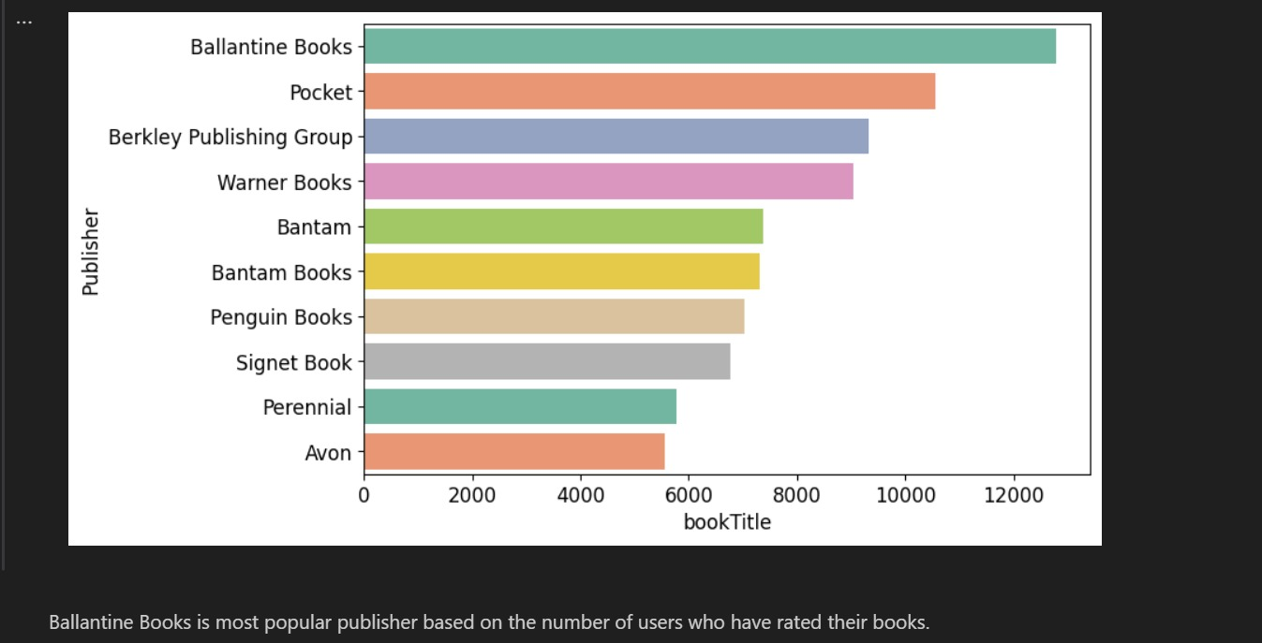
Publisher with most books

Slide 17
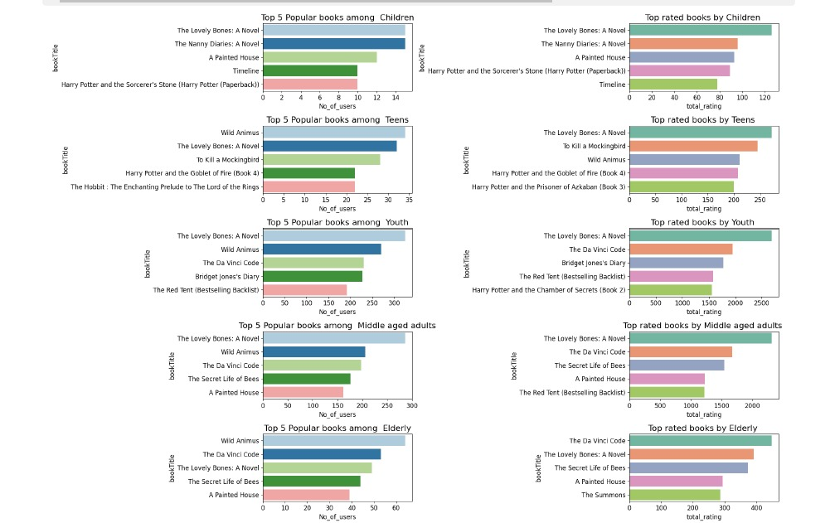
top rated and most popular book with respect to age group

Slide 18
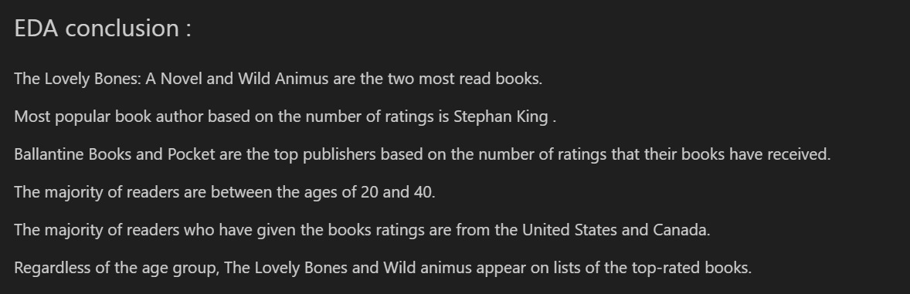
conclusion

Slide 19
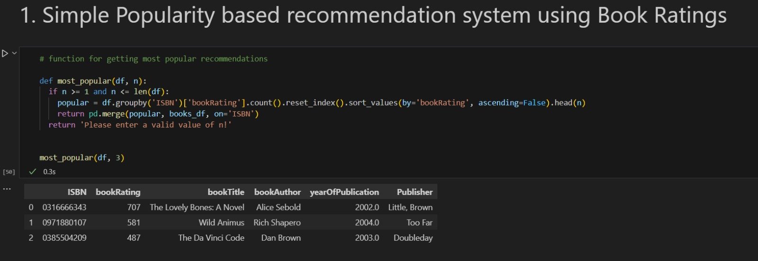
Popularity based recommendation system

Slide 20
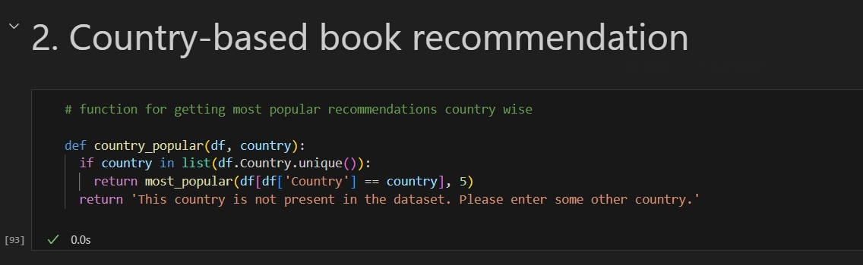

Slide 21
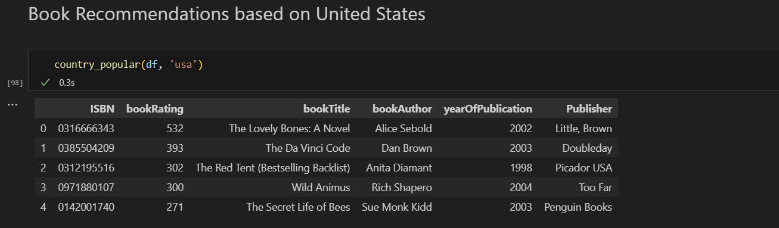

Slide 22
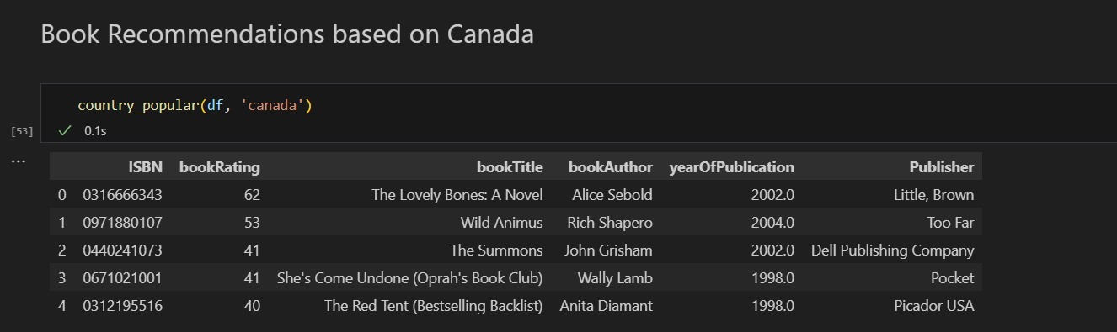

Slide 23
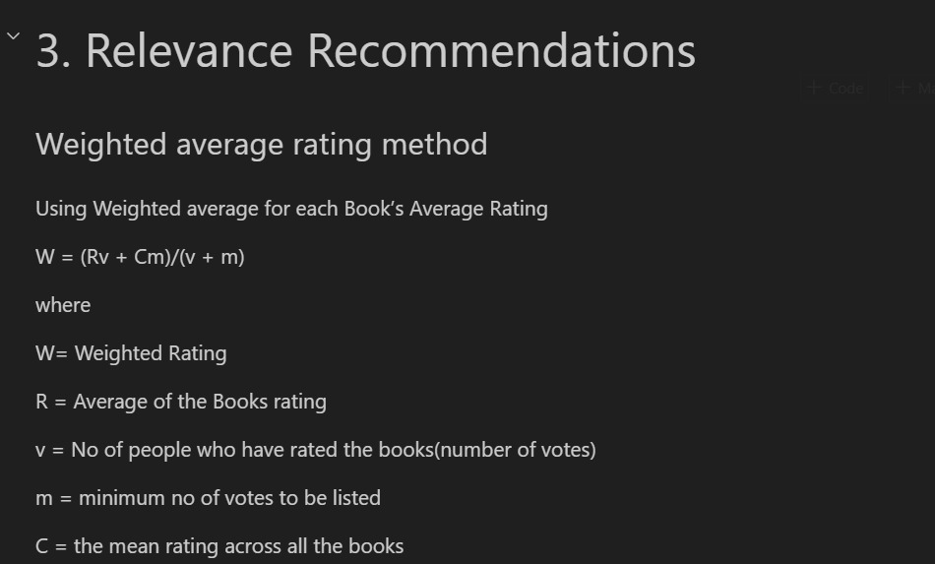

Slide 24
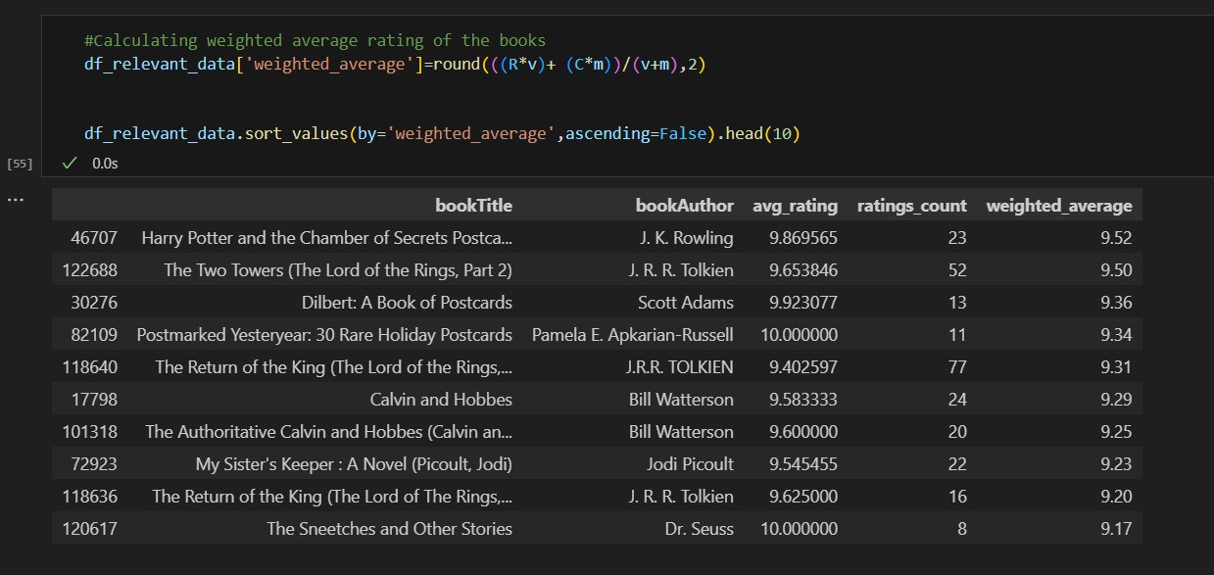

Slide 25
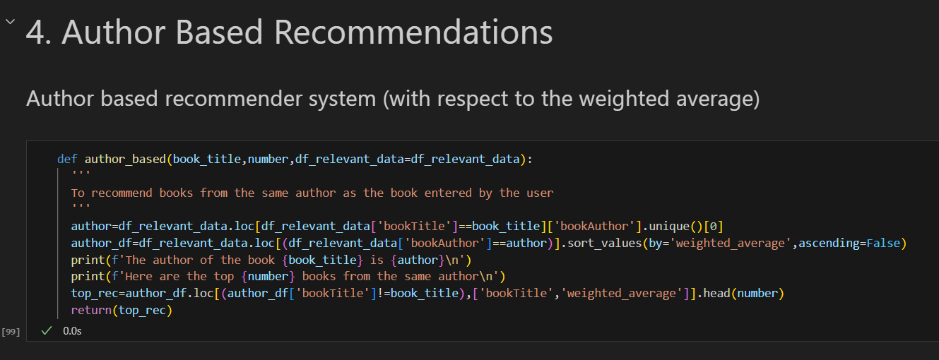

Slide 26
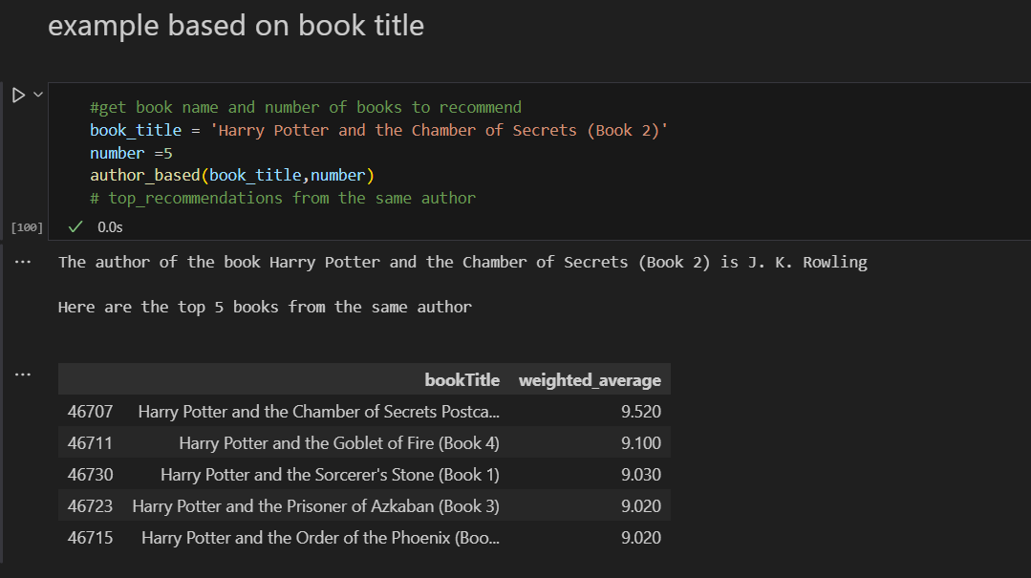

Slide 27
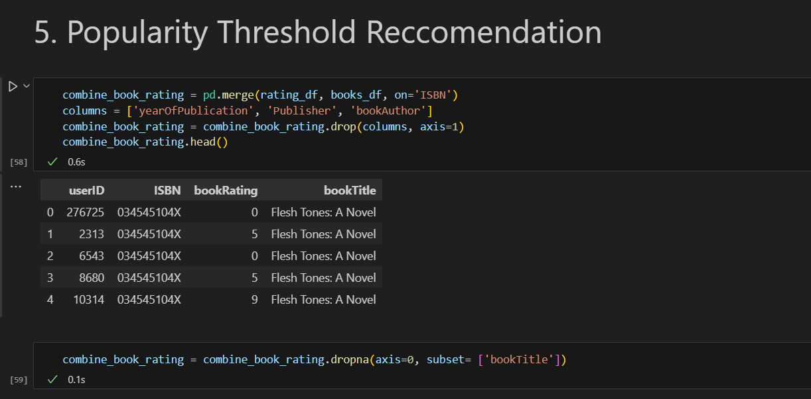

Slide 28
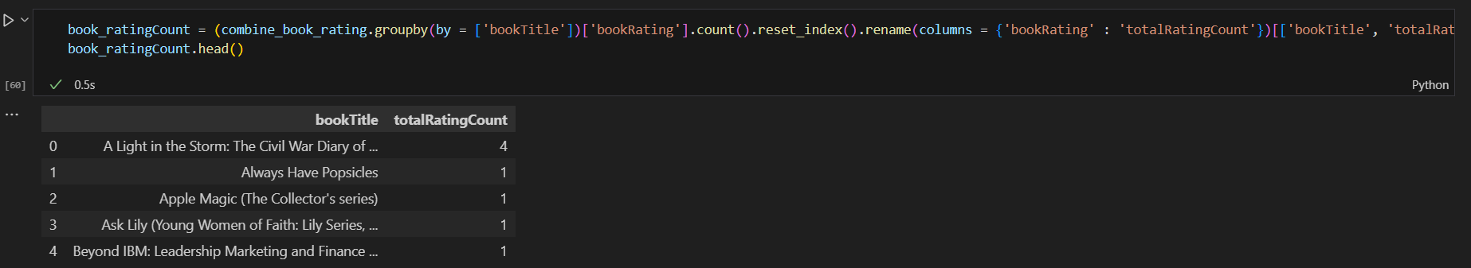
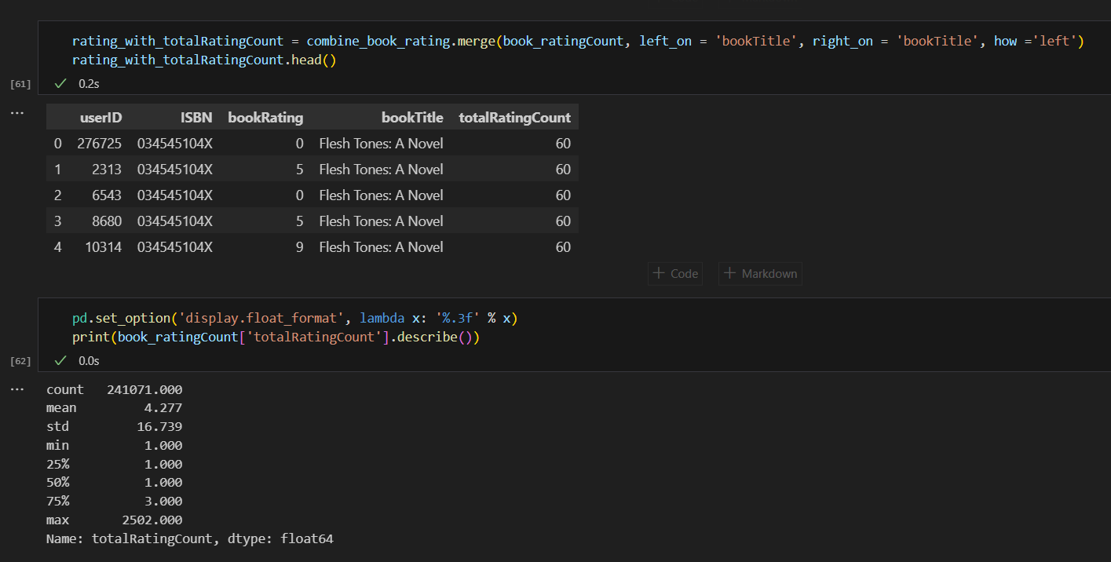

Slide 29
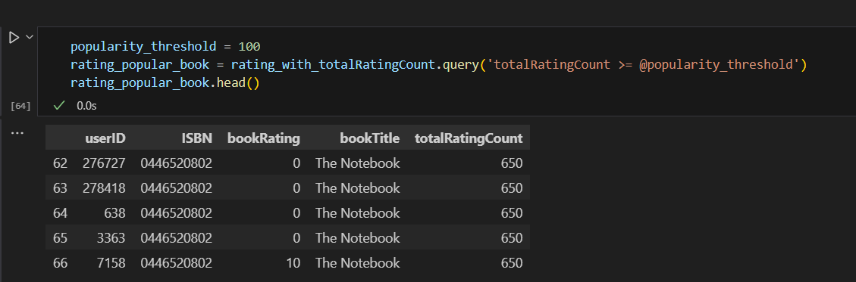

Slide 30
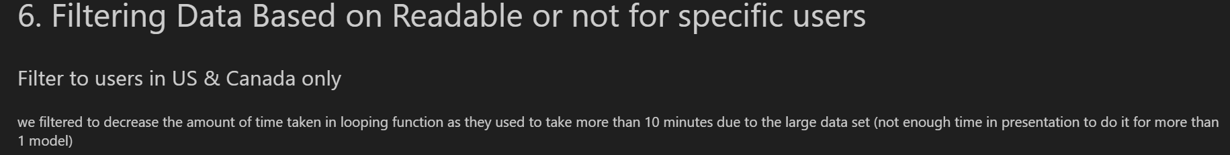
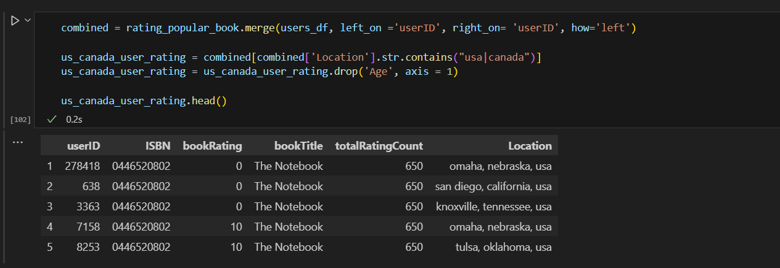

Slide 31

Any questions ?

